Slide 1
BIM Implementation Public Sector
Build Digital - Industry Colloquium for Information Management Deliverables

Slide 2
BIM Implementation Planning Phase 1 Public Sector Clients and Consultants
Build Digital - Industry Colloquium 16th June 2023 Presented by
Stephen Lynam MSc. B. Eng. MIEI
Technical Advisor Construction Contracts
Office of Government Procurement

Slide 3
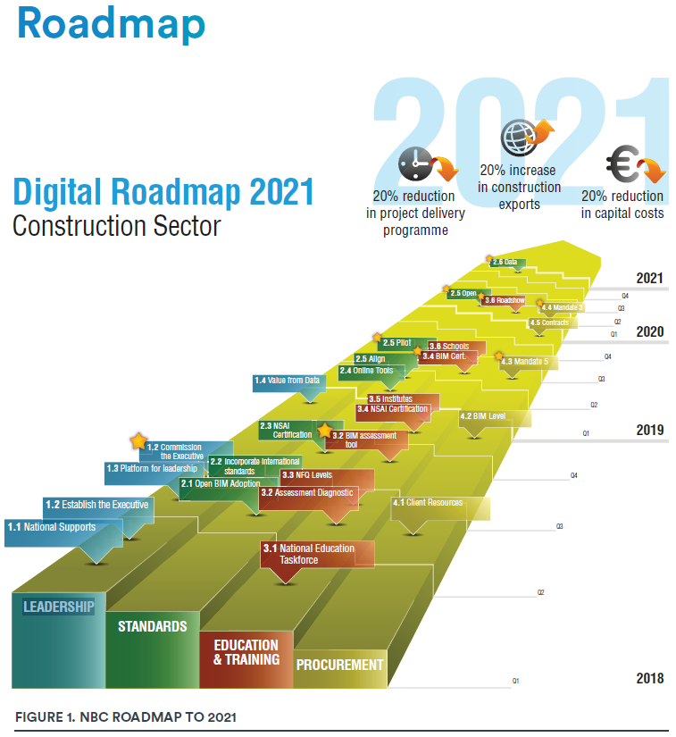
Agenda
Introduction
Implementation Strategy
Planning BIM Implementation in the Public Sector

Slide 4
Introduction
Public infrastructure procurement is governed by the Capital Works Management Framework (CWMF) using Public Works Contracts (PWC)
Our objective in adopting BIM processes into the CWMF is to promote the production of High Quality Information for use throughout a project’s lifecycle.
We are interested in the capacity of BIM to transform the design, procurement, construction and operation of public buildings and infrastructure from the point of view of the environment, quality, time and cost.
We have developed a strategy that encompasses different aspects across 3 phases – design, construction and operation
We have identified deliverables to assist the transition to BIM for construction that will be used by the Public Sector and may be used by the Private Sector.

Slide 5
Public Sector BIM Implementation Strategy
There are two aspects to the strategy:
Imposing standards for information across all stages of a project’s life cycle.
Supporting public bodies in the adoption of BIM.
There are three phases to the strategy:
CWMF stages (i) Inception to (iii) Tender Action.
CWMF stages (iv) Construction to (v) Handover
A new stage (vi) Asset Ownership.

Slide 6
Public Sector BIM Implementation Strategy
Aspect 1 – Imposing Standards - OGP:
ISO 19650 series will be adopted into the CWMF on a phased basis to impose standards on information for project delivery across the public sector.
Setting minimum information requirements for all stages of the CWMF

Slide 7
Public Sector BIM Implementation Strategy
Aspect 2 – Supporting Clients:
Series of masterclasses – 66% concluded – OGP
Template contracts - under consideration – OGP
Developing minimum standards for pre-qualification* – OGP/BD/NSAI
BIM specific templates & guidance – OGP/BD
Frameworks for IT hardware & software – OGP/BD
Training – BD/Others
*Certification of BIM Capability through NSAI

Slide 8
Public Sector BIM Implementation Strategy
Phase A – CWMF Stages (i) – (iii):
Mapping information requirements in stages (i) – (iii) – OGP
Establishing the LOIN requirements for stages (ii) – (iii) – OGP
Determining draft RACI matrix for information delivery stages (i) – (iii) – OGP/Stakeholders
Inclusion of BIM delivery requirements into scope of service for consultants – OGP
Publish template Scope of Service, Fee Breakdown, Amended Conditions of Engagement – OGP
Publish guidance for CWMF requirements– OGP
Mandatory use of BIM starting on large projects

Slide 9
Public Sector BIM Implementation Strategy
Phase B – CWMF Stages (iv) – (v):
Mapping information requirements in both stages – OGP
Establishing the LOIN requirements for both stages – OGP
Determining draft RACI matrix for information delivery for both stages – OGP/Stakeholders
Inclusion of BIM delivery requirements into Works Requirements – OGP
Publish template amended public works contract – OGP
Publish guidance for CWMF requirements– OGP
Mandatory use of BIM starting on large projects

Slide 10
Public Sector BIM Implementation Strategy
Phase C – CWMF New Stage (vi):
Setting reporting requirements for asset operators
Conducting reviews of asset in operation vs design objectives
Making recommendations for improvements in delivery stages (i) – (v)
Mandatory use of BIM starting on large projects

Slide 11
Project Requirements initial BIM Implementation
Project
Project Category Value | Task order and Milestones | Month
> 100m | Milestone 1 – Design Team only | Month 0
> 100m | Milestone 2 – Contractor and Supply Chain | Month 12
> 20m | Milestone 3 – Design Team only | Month 12
> 20m | Milestone 4 – Contractor and Supply Chain | Month 18
> 10m | Milestone 5 – Design Team only | Month 18
> 10m | Milestone 6 – Contractor and Supply Chain | Month 24
> 5m | Milestone – 7 Design Team only | Month 30
> 5m | Milestone 8 – Contractor and Supply Chain | Month 36
> 1m | Milestone 9 – Design Team only | Month 36
> 1m | Milestone 10 – Contractor and Supply Chain | Month 42
< 1m | Milestone 11 – Design Team only | Month 42
< 1m | Milestone 12 – Contractor and Supply Chain | Month 48

Slide 12
BIM IMPLEMENTATION TIMELINE
MILESTONE 1 • CWMF Projects > 100m
Projects
Phase 1 – Design Only
MILESTONE 3 • CWMF Projects > 20m
Phase 2 – Design Only
MILESTONE 5 • CWMF Projects > 10M
Phase 4 – Design Only
MILESTONE 7 • CWMF Projects > 5M
Phase 4 – Design Only
MILESTONE 9 • CWMF Projects < 1M
Phase 4 – Design Only
MILESTONE 11• CWMF Projects > 1M
Phase 4 – Design Only
Initiate Q1 - 24 | Q3 - 24 | Q1 - 25 | Q3 - 25 | Q1 - 26 | Q3 - 26 | Q1 - 27 | Q - 27
MILESTONE 2 • CWMF Projects > 100m
Phase 5 – Contractor and Supply Chain
MILESTONE 4 • CWMF Projects > 20m
Phase 5 – Contractor and Supply Chain
MILESTONE 6 • CWMF Projects > 10m
Phase 5 – Contractor and Supply Chain
MILESTONE 8 • CWMF Projects > 5m
Phase 5 – Contractor and Supply Chain
MILESTONE 10 • CWMF Projects > 1m
Phase 5 – Contractor and Supply Chain
MILESTONE 12• CWMF Projects < 1M
Phase 7 – Contractor and Supply Chain
Task 1: Month 1 to 12
Task 3: Month 18 to 30
Task 5: Month 30 to 42
Task 2: Month 12 to 24
Task 4: Month 24 to 36
Task 6: Month 36 to 48
OGP BIM IMPLEMENTATION PLANNING TIMELINE

Slide 13
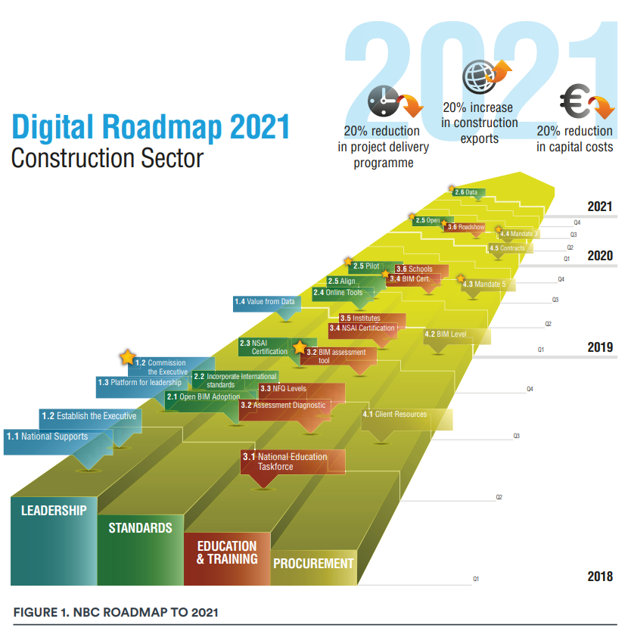
Thank You For Your Time

